Slide 1
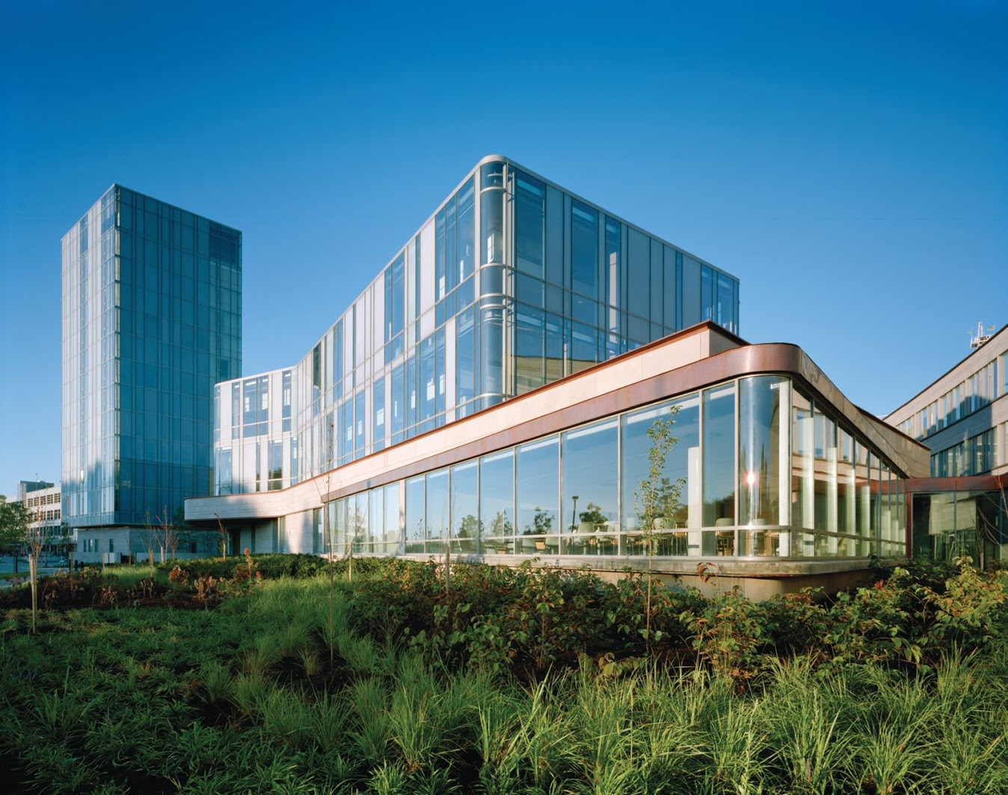
`
Schulich School of Business MBAN 6120
MODULE 11 : Estimation, ARIMA
Data Science II
Instructor: Boris Garbuzov
MBAN 6120
Fall 2020
SCHULICH SCHOOL OF BUSINESS | MBAN 6120
MODULE 1
Data Science II
2020

Slide 2
Chapter 3 ARIMA Models
3.5 Estimation

Slide 3
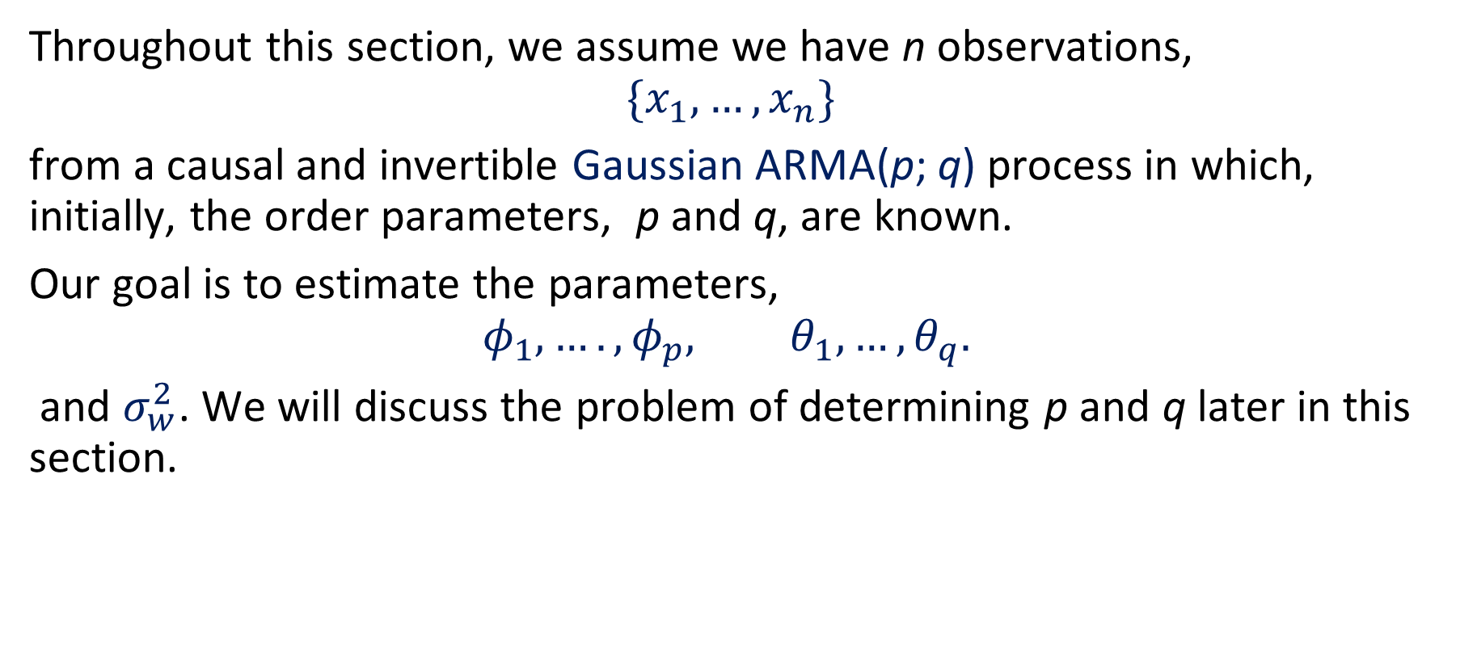
State of problem
Throughout this section, we assume we have n observations,
$$\{x_{1},…, x_{n}\}$$
from a causal and invertible Gaussian ARMA(p; q) process in which, initially, the order parameters, p and q, are known.
Our goal is to estimate the parameters,
$$φ_{1},…., φ_{p}, θ_{1},…, θ_{q}.$$
and $σ_{w}^{2}$. We will discuss the problem of determining p and q later in this section.

Slide 4
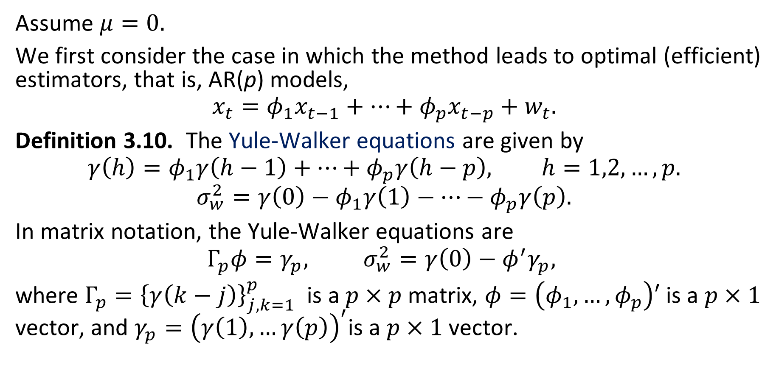
Method of moments
Assume $μ=0.$
We first consider the case in which the method leads to optimal (efficient) estimators, that is, AR(p) models,
$$x_{t}=φ_{1}x_{t−1}+…+φ_{p}x_{t−p}+w_{t}.$$
Definition 3.10. The Yule-Walker equations are given by
$$γ\left(h\right)=φ_{1}γ\left(h−1\right)+…+φ_{p}γ\left(h−p\right), h=1,2,…, p.$$
$$σ_{w}^{2}=γ\left(0\right)−φ_{1}γ\left(1\right)−…−φ_{p}γ\left(p\right).$$
In matrix notation, the Yule-Walker equations are
$$Γ_{p}φ=γ_{p}, σ_{w}^{2}=γ\left(0\right)−φ^{′}γ_{p},$$
where $Γ_{p}={\left\{γ\left(k−j\right)\right\}}_{j,k=1}^{p}$ is a $p×p$ matrix, $φ=\left(φ_{1},…, φ_{p}\right)′$ is a $p×1$ vector, and $γ_{p}={\left(γ\left(1\right),…γ\left(p\right)\right)}^{′}$is a $p×1$ vector.

Slide 5
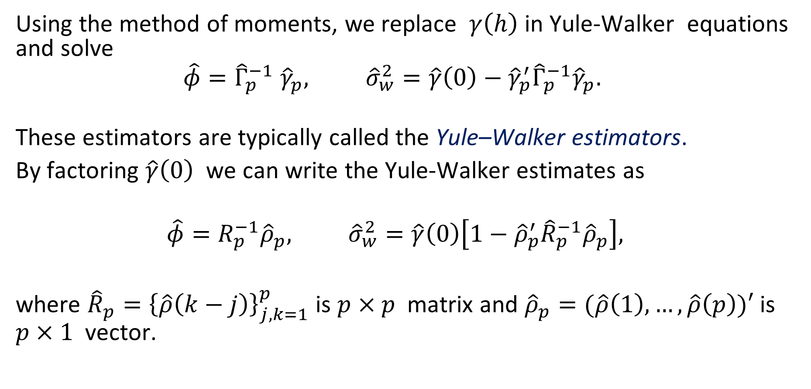
Yule–Walker estimators
Using the method of moments, we replace $γ\left(h\right)$ in Yule-Walker equations and solve
$$\hat{φ}={\hat{Γ}}_{p}^{−1} {\hat{γ}}_{p}, {\hat{σ}}_{w}^{2}=\hat{γ}\left(0\right)−{\hat{γ}}_{p}^{′}{\hat{Γ}}_{p}^{−1}{\hat{γ}}_{p}.$$
These estimators are typically called the Yule–Walker estimators.
By factoring $\hat{γ}\left(0\right)$ we can write the Yule-Walker estimates as
$$\hat{φ}=R_{p}^{−1}{\hat{ρ}}_{p}, {\hat{σ}}_{w}^{2}=\hat{γ}\left(0\right)\left[1−{\hat{ρ}}_{p}^{′}{\hat{R}}_{p}^{−1}{\hat{ρ}}_{p}\right],$$
where ${\hat{R}}_{p}={\left\{\hat{ρ}\left(k−j\right)\right\}}_{j,k=1}^{p}$ is $p×p$ matrix and ${\hat{ρ}}_{p}=(\hat{ρ}\left(1\right), …, \hat{ρ}\left(p\right))′$ is $p×1$ vector.

Slide 6
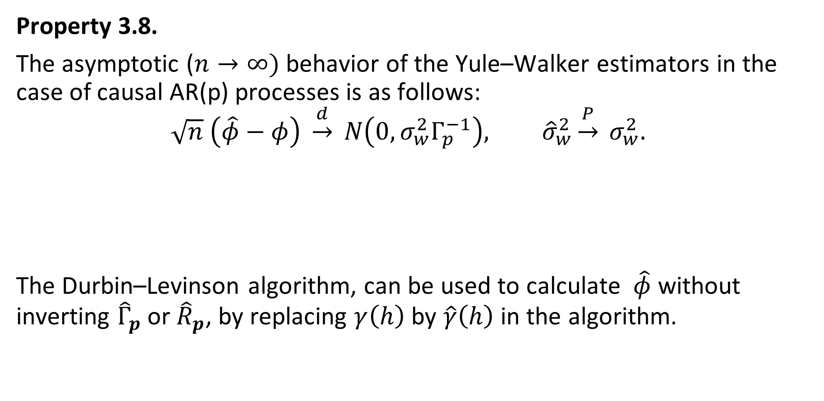
Property 3.8 Large Sample Results for Yule–Walker Estimators
Property 3.8.
The asymptotic ($n→∞)$ behavior of the Yule–Walker estimators in the case of causal AR(p) processes is as follows:
$$\sqrt{n} \left(\hat{φ}−φ\right) \underset{→}{d} N\left(0, σ_{w}^{2}Γ_{p}^{−1}\right), {\hat{σ}}_{w}^{2}\underset{→}{P} σ_{w}^{2}.$$
The Durbin–Levinson algorithm, can be used to calculate $\hat{φ}$ without inverting ${\hat{Γ}}_{p}$ or ${\hat{R}}_{p}$, by replacing $γ\left(h\right)$ by $\hat{γ}\left(h\right)$ in the algorithm.

Slide 7

Property 3.9 Large Sample Distribution of the PACF
Property 3.9.
For a causal AR(p) process, asymptotically ($n→∞$), $$\sqrt{n} {\hat{φ}}_{hh}\underset{→}{d} N\left(0, 1\right), for h>p.$$

Slide 8
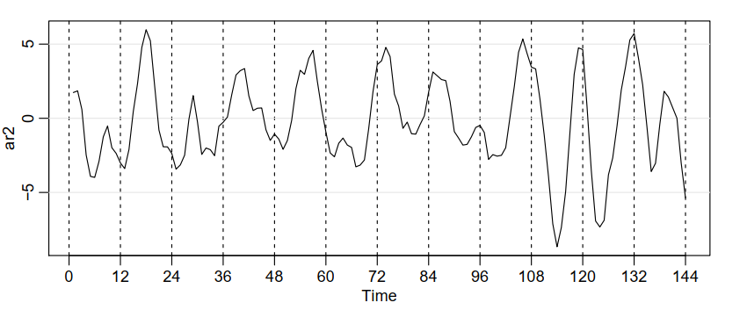

Example 3.27 Yule–Walker Estimation for an AR(2) Process
Example 3.27
The data shown in Figure 3.4 were n = 144 simulated observations from the AR(2) model
$$x_{t}=1.5 x_{t−1}−0.75 x_{t−2}+w_{t}$$
where $w_{t}∼iid N\left(0,1\right).$

Slide 9



Example 3.27 Yule–Walker Estimation for an AR(2) Process (continued)
For these data, $\hat{γ}\left(0\right)=8.902,$ $\hat{ρ}\left(1\right)=0.849,$ and $\hat{ρ}\left(2\right)=0.519.$
Thus,
and

Slide 10
Example 3.28 Yule–Walker Estimation of the Recruitment Series
Below are the results of fitting the model AR(2) for Recruitment series using Yule-Walker estimation in R, which are nearly identical to the values in Example 3.18.
rec.yw = ar.yw(rec, order=2)
rec.yw$x.mean # = 62.26 (mean estimate)
rec.yw$ar # = 1.33, -.44 (coefficient estimates)
sqrt(diag(rec.yw$asy.var.coef)) # = .04, .04 (standard errors)
rec.yw$var.pred # = 94.80 (error variance estimate)
To obtain the 24 month ahead predictions and their standard errors, and then
plot the results, use the R commands:
rec.pr = predict(rec.yw, n.ahead=24)
ts.plot(rec, rec.pr$pred, col=1:2)
lines(rec.pr$pred + rec.pr$se, col=4, lty=2)
lines(rec.pr$pred - rec.pr$se, col=4, lty=2)

Slide 11
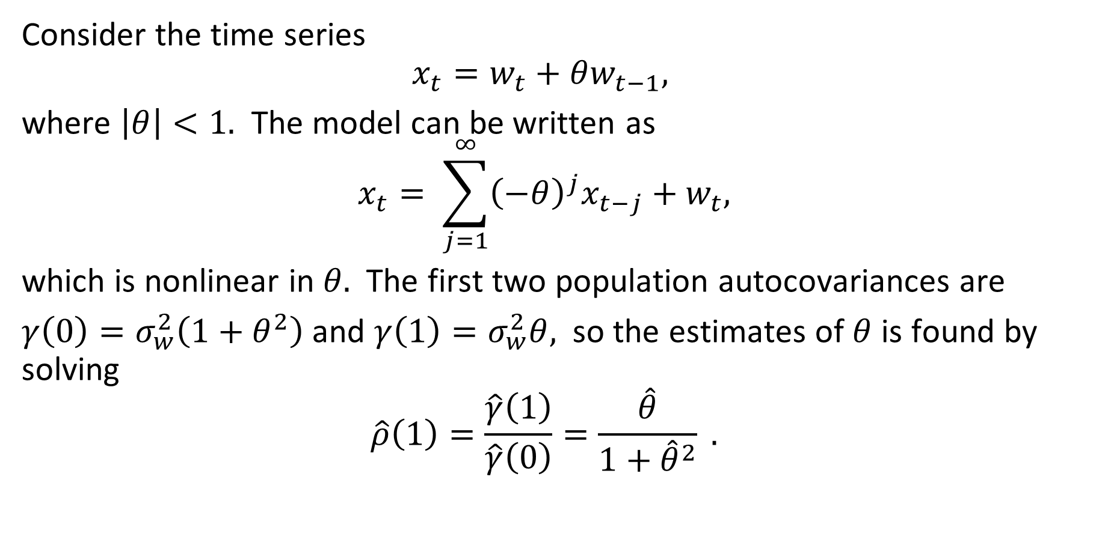
Example 3.29 Method of Moments Estimation for an MA(1)
Consider the time series
$$x_{t}=w_{t}+θw_{t−1},$$
where $\left|θ\right|<1.$ The model can be written as
$$x_{t}= \sum_{j=1}^{∞}{{\left(−θ\right)}^{j}x_{t−j}+w_{t},}$$
which is nonlinear in $θ.$ The first two population autocovariances are
$γ\left(0\right)=σ_{w}^{2}\left(1+θ^{2}\right)$ and $γ\left(1\right)=σ_{w}^{2}θ,$ so the estimates of $θ$ is found by solving
$$\hat{ρ}\left(1\right)=\frac{\hat{γ}\left(1\right)}{\hat{γ}\left(0\right)}=\frac{\hat{θ}}{1+{\hat{θ}}^{2}} .$$

Slide 12
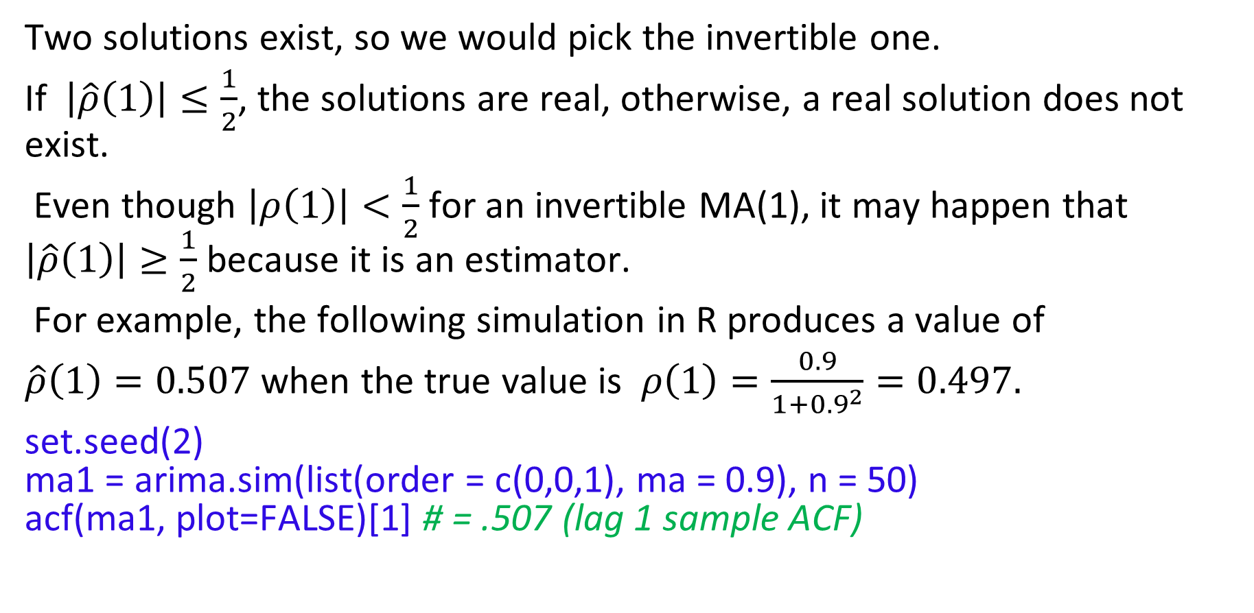
Example 3.29 Method of Moments Estimation for an MA(1) (continued)
Two solutions exist, so we would pick the invertible one.
If $\left|\hat{ρ}\left(1\right)\right|≤\frac{1}{2}$, the solutions are real, otherwise, a real solution does not exist.
Even though $\left|ρ\left(1\right)\right|<\frac{1}{2}$ for an invertible MA(1), it may happen that $\left|\hat{ρ}\left(1\right)\right|≥\frac{1}{2}$ because it is an estimator.
For example, the following simulation in R produces a value of
when the true value is $ρ\left(1\right)=\frac{0.9}{1+{0.9}^{2}}=0.497.$
set.seed(2) ma1 = arima.sim(list(order = c(0,0,1), ma = 0.9), n = 50) acf(ma1, plot=FALSE)[1] # = .507 (lag 1 sample ACF)

Slide 13

Final’s practice. Estimation
You collected the following historical data
x1 x2 x3 x4
1 2 3 4
Q1. Assuming that the process $x_{t}$is stationary, estimate its autocovariance of lags 0 and 1.
Q2. Assuming that this process is invertible MA(1), find its parameters, namely, $θ$ coefficient and the variance of white noise $σ^{2}$, using method of moments. To that end, go through the following steps.
Q2a. Derive the equations, connecting autocovariances $γ(0)$ and $γ(1)$to parameters $θ$ and $σ^{2}$.
Q2b. Invert this system, expressing parameters $θ$ and $σ^{2}$in terms of autocovariances $γ(0)$ and $γ\left(1\right).$
Q2c. Plug in your computations of autocovariance, to find the final estimates $θ$ and $σ^{2}$.

Slide 14
Final’s practice. Estimation. R
Consider the following code:
rec.yw = ar.yw(rec, order=2) # fit
Explain the following field of the fit object
rec.yw$var.pred

Slide 15
Final’s practice. Estimation. R
Consider the following code:
rec.yw = ar.yw(rec, order=2) # fit
How to extract coefficients' variances?
Select all that applies:
diag(rec.yw$asy.var.coef)
c(rec.yw$asy.var.coef[1, 1], rec.yw$asy.var.coef[1, 1])
t(rec.yw$asy.var.coef)
rec.yw$var.pred

Slide 16
Final’s practice. Estimation. R
Once again, consider the following line of code:
rec.yw = ar.yw(rec, order=2) # fit
Which line of code below will extract estimated coefficients for the fitted model?
rec.yw$ar
rec.yw$order
coef(rec.yw)
ar(rec.yw)

Slide 17
Chapter 3 ARIMA Models
3.6 Integrated Models for Nonstationary Data

Slide 18
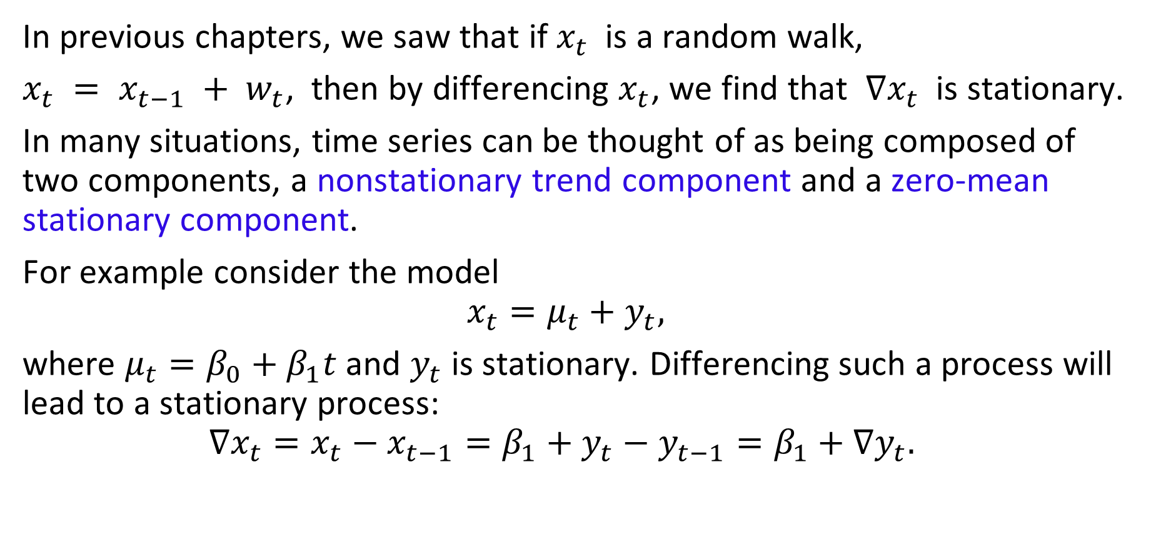
Motivation
In previous chapters, we saw that if $x_{t}$ is a random walk,
$x_{t} = x_{t−1} + w_{t}$, then by differencing $x_{t}$, we find that $∇x_{t}$ is stationary.
In many situations, time series can be thought of as being composed of two components, a nonstationary trend component and a zero-mean stationary component.
For example consider the model
$$x_{t}=μ_{t}+y_{t},$$
where $μ_{t}=β_{0}+β_{1}t$ and $y_{t}$ is stationary. Differencing such a process will lead to a stationary process:
$$∇x_{t}=x_{t}−x_{t−1}=β_{1}+y_{t}−y_{t−1}=β_{1}+∇y_{t}.$$

Slide 19
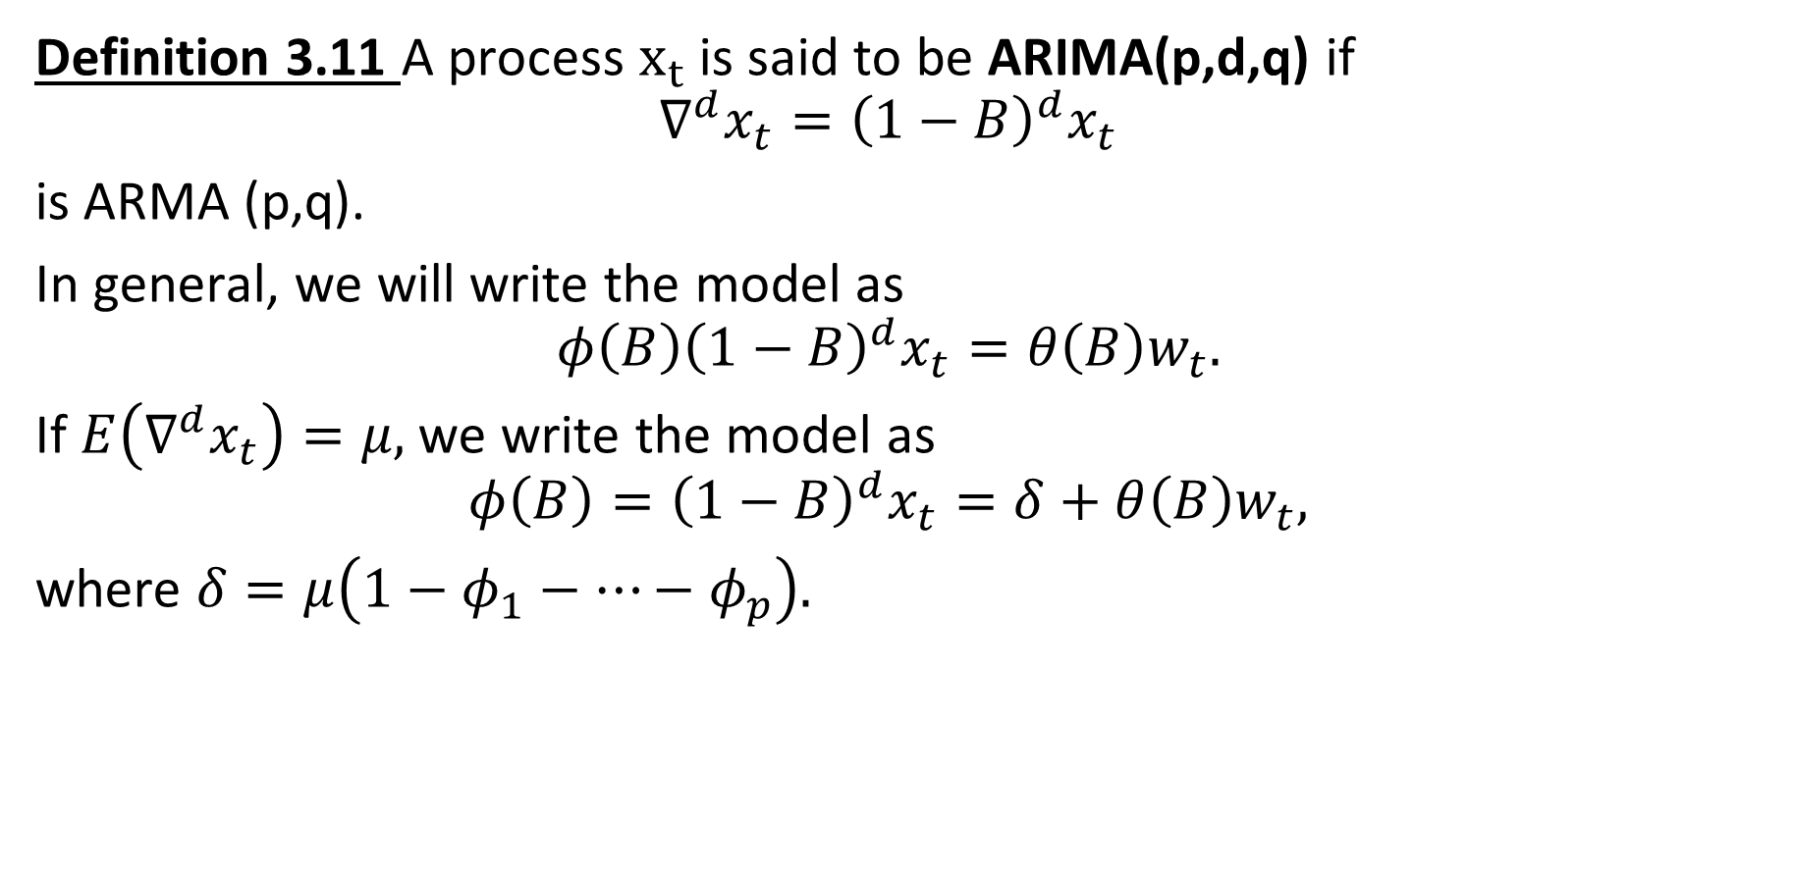
Definition of ARIMA (p,d,q)
Definition 3.11 A process $x_{t}$ is said to be ARIMA(p,d,q) if
$$∇^{d}x_{t}={\left(1−B\right)}^{d}x_{t}$$
is ARMA (p,q).
In general, we will write the model as
$$φ\left(B\right){\left(1−B\right)}^{d}x_{t}=θ\left(B\right)w_{t}.$$
If $E\left(∇^{d}x_{t}\right)=μ,$ we write the model as
$$φ\left(B\right)={\left(1−B\right)}^{d}x_{t}=δ+θ\left(B\right)w_{t},$$
where $δ=μ\left(1−φ_{1}−…−φ_{p}\right).$

Slide 20
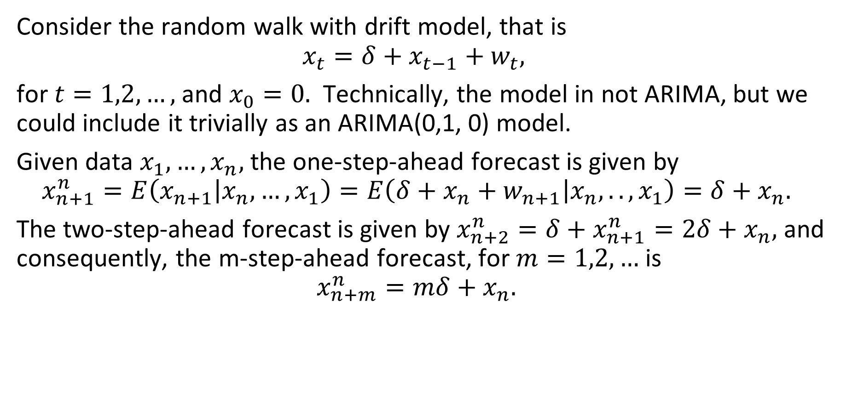
Example 3.37 Random Walk with Drift
Consider the random walk with drift model, that is
$$x_{t}=δ+x_{t−1}+w_{t},$$
for $t=1,2,…,$ and $x_{0}=0.$ Technically, the model in not ARIMA, but we could include it trivially as an ARIMA(0,1, 0) model.
Given data $x_{1},…, x_{n},$ the one-step-ahead forecast is given by
$$x_{n+1}^{n}=E\left(x_{n+1} | x_{n},…, x_{1}\right)=E\left(δ+x_{n}+w_{n+1} | x_{n}, .. , x_{1}\right)=δ+x_{n}.$$
The two-step-ahead forecast is given by $x_{n+2}^{n}=δ+x_{n+1}^{n}=2δ+x_{n},$ and consequently, the m-step-ahead forecast, for $m=1,2,…$ is
$$x_{n+m}^{n}=mδ+x_{n}.$$

Slide 21
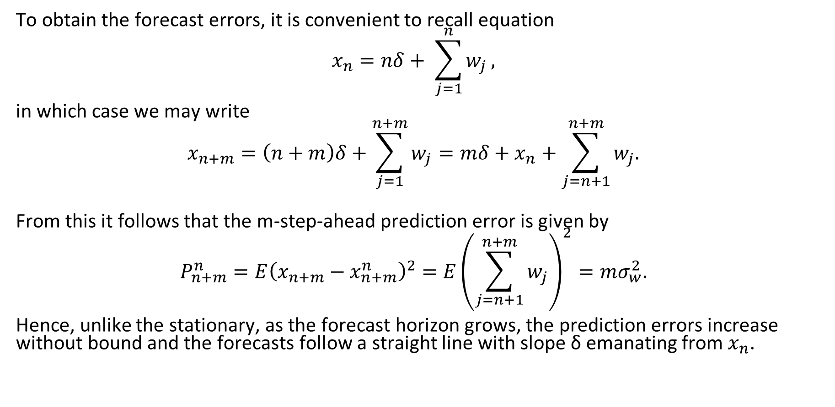
Example 3.37 Random Walk with Drift (continued)
To obtain the forecast errors, it is convenient to recall equation
$$x_{n}=nδ+ \sum_{j=1}^{n}{w_{j}},$$
in which case we may write
$$x_{n+m}=\left(n+m\right)δ+\sum_{j=1}^{n+m}{w_{j}}=mδ+x_{n}+\sum_{j=n+1}^{n+m}{w_{j}.}$$
From this it follows that the m-step-ahead prediction error is given by
$$P_{n+m}^{n}=E{\left(x_{n+m}−x_{n+m}^{n}\right)}^{2}=E{\left(\sum_{j=n+1}^{n+m}{w_{j}}\right)}^{2}=mσ_{w}^{2}.$$
Hence, unlike the stationary, as the forecast horizon grows, the prediction errors increase without bound and the forecasts follow a straight line with slope δ emanating from $x_{n}$.

Slide 22
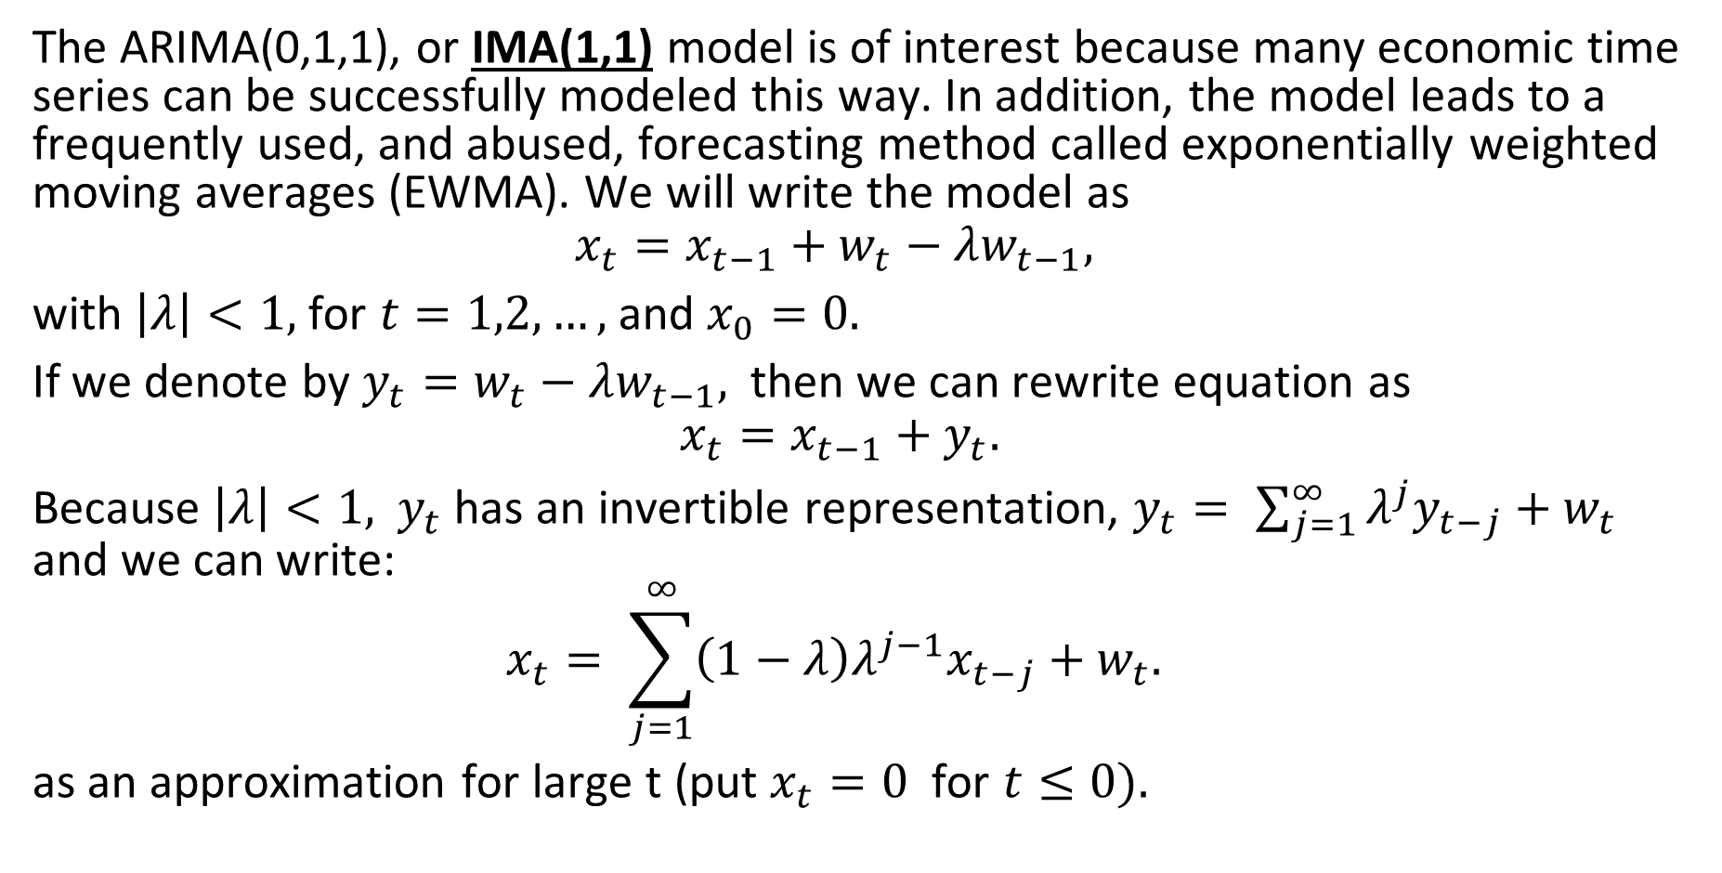
Example 3.38 IMA(1,1) and EWMA
The ARIMA(0,1,1), or IMA(1,1) model is of interest because many economic time series can be successfully modeled this way. In addition, the model leads to a frequently used, and abused, forecasting method called exponentially weighted moving averages (EWMA). We will write the model as
$$x_{t}=x_{t−1}+w_{t}−λw_{t−1},$$
with $\left|λ\right|<1,$ for $t=1,2,…,$ and $x_{0}=0.$
If we denote by $y_{t}=w_{t}−λw_{t−1},$ then we can rewrite equation as
$$x_{t}=x_{t−1}+y_{t}.$$
Because $\left|λ\right|<1,$ $y_{t}$ has an invertible representation, $y_{t}= \sum_{j=1}^{∞}{λ^{j}y_{t−j}+w_{t}}$ and we can write:
$$x_{t}= \sum_{j=1}^{∞}{\left(1−λ\right)λ^{j−1}x_{t−j}+w_{t}. }$$
as an approximation for large t (put $x_{t}=0$ for $t≤0).$

Slide 23
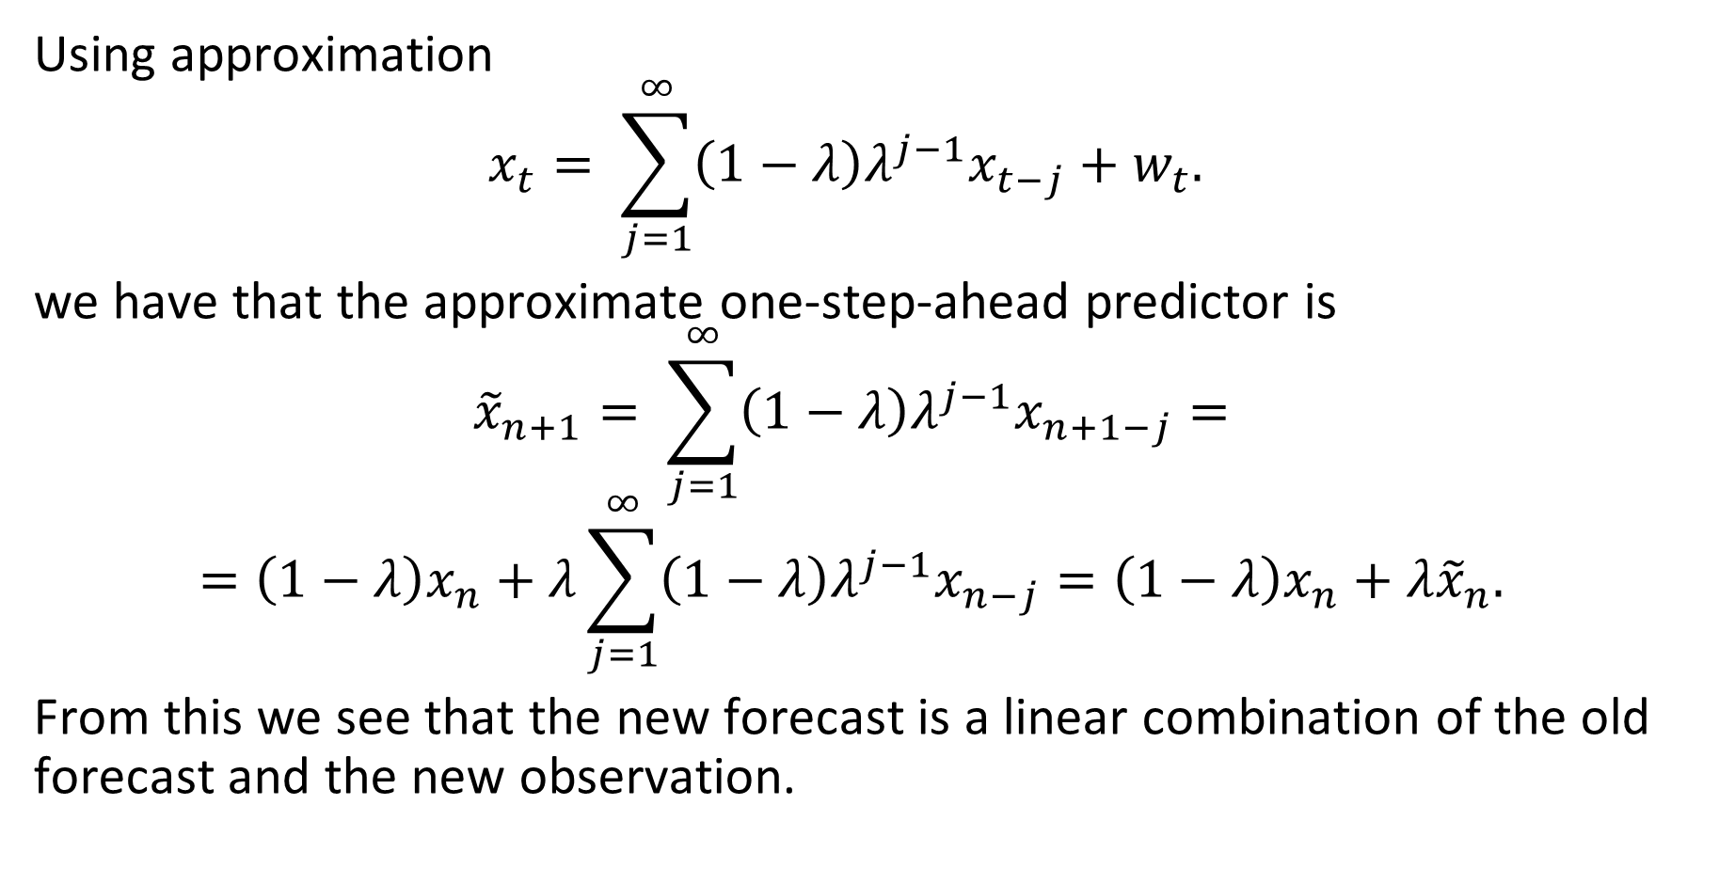
Example 3.38 IMA(1,1) and EWMA(continued)
Using approximation
$$x_{t}= \sum_{j=1}^{∞}{\left(1−λ\right)λ^{j−1}x_{t−j}+w_{t}. }$$
we have that the approximate one-step-ahead predictor is
$${\tilde{x}}_{n+1}= \sum_{j=1}^{∞}{\left(1−λ\right)λ^{j−1}x_{n+1−j}}=$$
$$=\left(1−λ\right)x_{n}+λ\sum_{j=1}^{∞}{\left(1−λ\right)λ^{j−1}x_{n−j}}=\left(1−λ\right)x_{n}+λ{\tilde{x}}_{n}.$$
From this we see that the new forecast is a linear combination of the old forecast and the new observation.

Slide 24
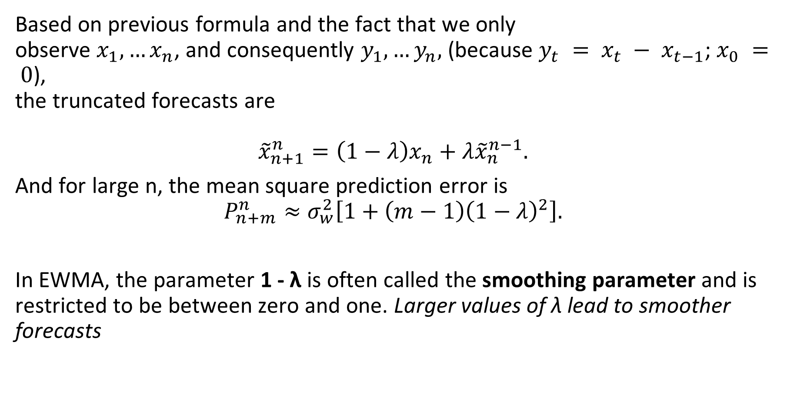
Example 3.38 IMA(1,1) and EWMA(continued)
Based on previous formula and the fact that we only observe $x_{1},…x_{n}$, and consequently $y_{1},…y_{n},$(because $y_{t} = x_{t} − x_{t−1}$; $x_{0} = 0$), the truncated forecasts are
$${\tilde{x}}_{n+1}^{n}=\left(1−λ\right)x_{n}+λ{\tilde{x}}_{n}^{n−1}.$$
And for large n, the mean square prediction error is
$$P_{n+m}^{n}≈σ_{w}^{2}\left[1+\left(m−1\right){\left(1−λ\right)}^{2}\right].$$
In EWMA, the parameter 1 - λ is often called the smoothing parameter and is restricted to be between zero and one. Larger values of λ lead to smoother forecasts

Slide 25
Chapter 3 ARIMA Models
3.7 Building ARIMA Models

Slide 26
Basic steps to fitting ARIMA models
There are a few basic steps to fitting ARIMA models to time series data. These steps involve: • plotting the data, • possibly transforming the data, • identifying the dependence orders of the model, • parameter estimation, • diagnostics, and • model choice

Slide 27
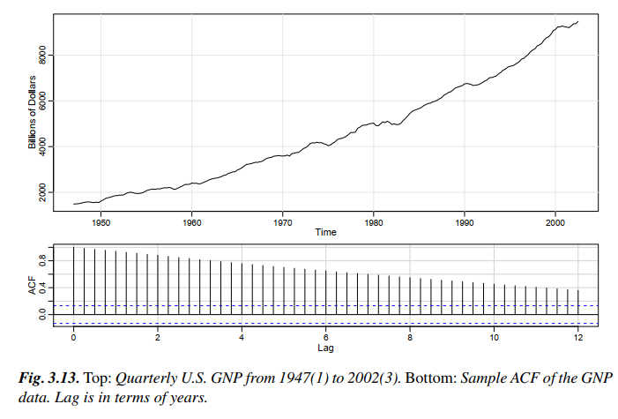
Example 3.39 Analysis of GNP Data
In this example, we consider the analysis of quarterly U.S. GNP from 1947(1) to 2002(3), n = 223 observations. The data are real U.S. gross national product in billions of chained 1996 dollars and have been seasonally adjusted. The data were obtained from the Federal Reserve Bank of St. Louis (http://research.stlouisfed.org/).

Slide 28
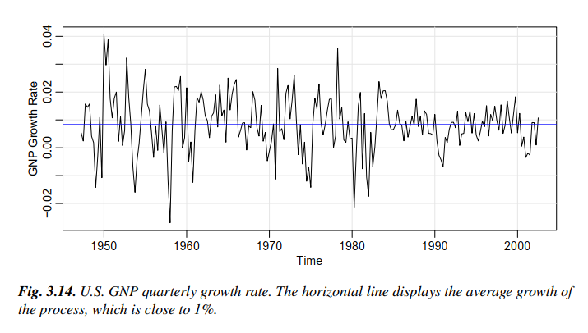
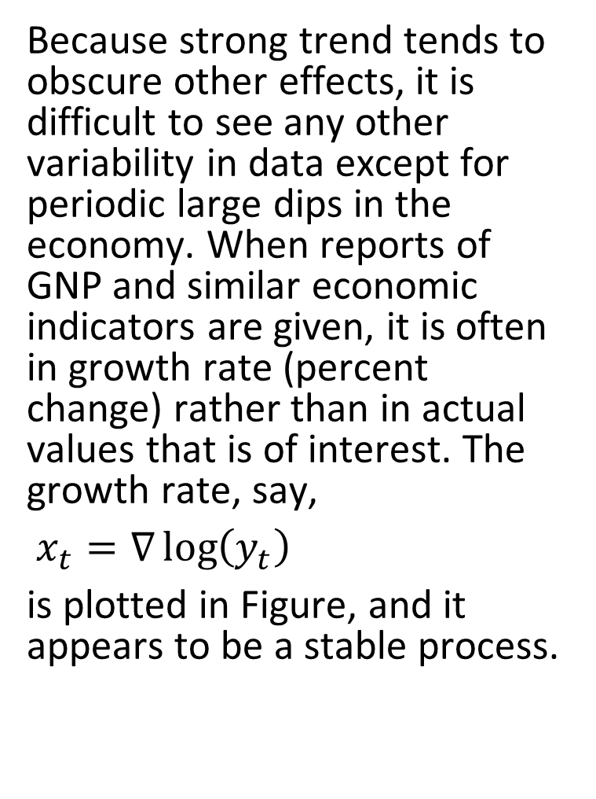
Example 3.39 Analysis of GNP Data(continued)
Because strong trend tends to obscure other effects, it is difficult to see any other variability in data except for periodic large dips in the economy. When reports of GNP and similar economic indicators are given, it is often in growth rate (percent change) rather than in actual values that is of interest. The growth rate, say,
$x_{t}=∇\log\left(y_{t}\right)$
is plotted in Figure, and it appears to be a stable process.

Slide 29
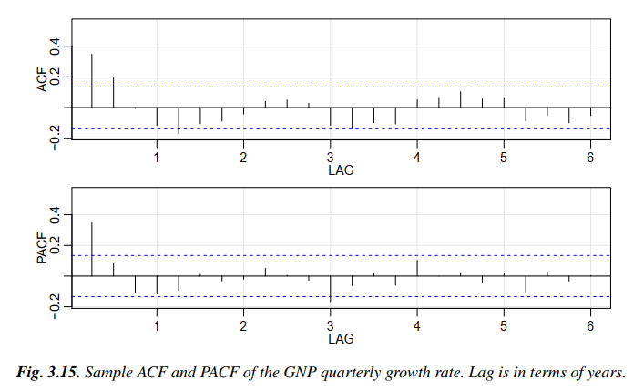
Example 3.39 Analysis of GNP Data(continued)
The sample ACF and PACF of the quarterly growth rate are plotted in Figure.
Inspecting the sample ACF and PACF, we might feel that the ACF is cutting off at lag 2 and the PACF is tailing off.
This would suggest the GNP growth rate follows an MA(2) process, or log GNP follows an ARIMA(0,1,2) model. We will also suggest that it appears that the ACF is tailing off and the PACF is cutting off at lag 1.
This suggests an AR(1) model for the growth rate, or ARIMA(1; 1; 0) for log GNP. As a preliminary analysis, we will fit both models.

Slide 30

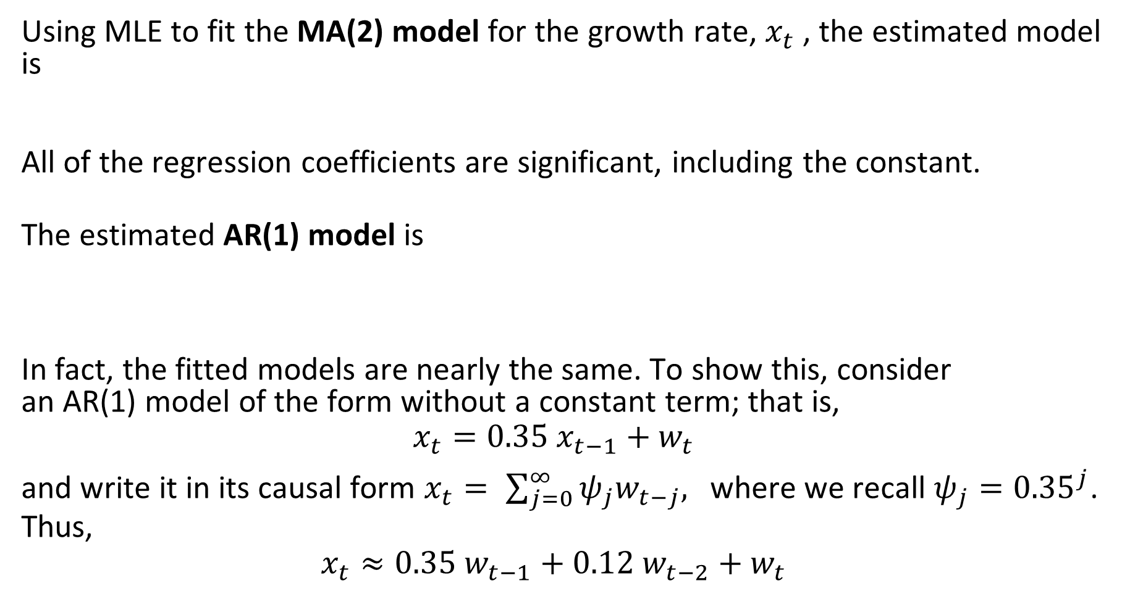
Example 3.39 Analysis of GNP Data(continued)
Using MLE to fit the MA(2) model for the growth rate, $x_{t}$ , the estimated model is
All of the regression coefficients are significant, including the constant. The estimated AR(1) model is
In fact, the fitted models are nearly the same. To show this, consider an AR(1) model of the form without a constant term; that is,
$$x_{t}=0.35 x_{t−1}+w_{t}$$ and write it in its causal form $x_{t}= \sum_{j=0}^{∞}{ψ_{j}w_{t−j}, }$ where we recall $ψ_{j}={0.35}^{j}$. Thus,
$$x_{t}≈0.35 w_{t−1}+0.12 w_{t−2}+w_{t}$$

Slide 31
Example 3.39 Analysis of GNP Data(continued)
The analysis can be performed in R as follows.
plot(gnp)
acf2(gnp, 50)
gnpgr = diff(log(gnp)) # growth rate
plot(gnpgr)
acf2(gnpgr, 24)
sarima(gnpgr, 1, 0, 0) # AR(1)
sarima(gnpgr, 0, 0, 2) # MA(2)
ARMAtoMA(ar=.35, ma=0, 10) # prints psi-weights

Slide 32
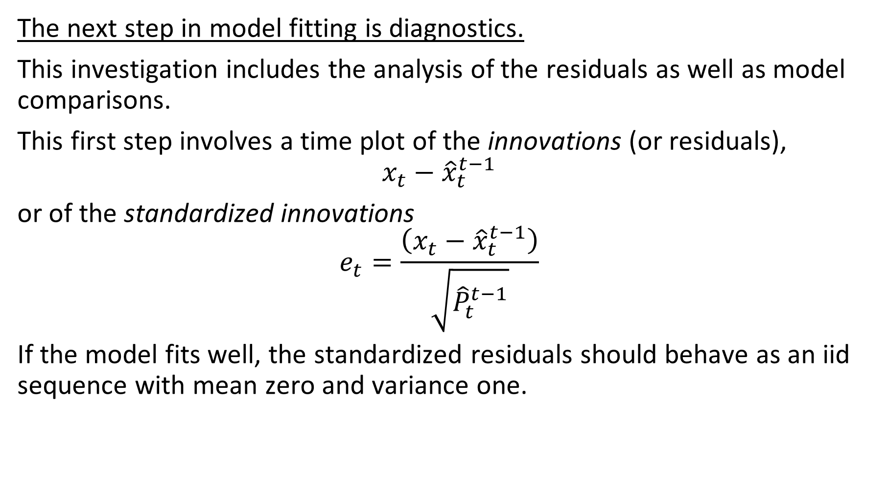
Diagnostics
The next step in model fitting is diagnostics.
This investigation includes the analysis of the residuals as well as model comparisons.
This first step involves a time plot of the innovations (or residuals),
$$x_{t}−{\hat{x}}_{t}^{t−1}$$
or of the standardized innovations
$$e_{t}=\frac{\left(x_{t}−{\hat{x}}_{t}^{t−1}\right)}{\sqrt{{\hat{P}}_{t}^{t−1}}}$$
If the model fits well, the standardized residuals should behave as an iid sequence with mean zero and variance one.

Slide 33
Diagnostics
The time plot should be inspected for any obvious departures from this assumption. Unless the time series is Gaussian, it is not enough that the residuals are uncorrelated. For example, it is possible in the non-Gaussian case to have an uncorrelated process for which values contiguous in time are highly dependent. Investigation of marginal normality can be accomplished visually by looking at a histogram of the residuals. In addition to this, a normal probability plot or a Q-Q plot can help in identifying departures from normality.

Slide 34
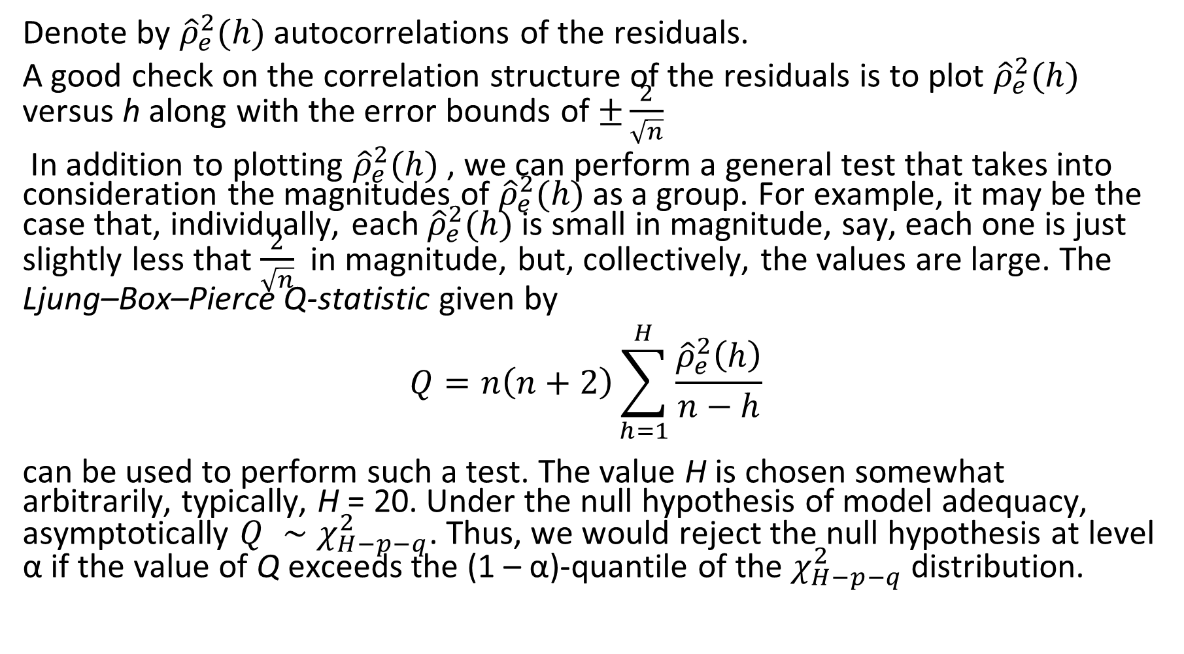
Ljung–Box–Pierce Q-statistic
Denote by ${\hat{ρ}}_{e}^{2}(h)$ autocorrelations of the residuals.
A good check on the correlation structure of the residuals is to plot ${\hat{ρ}}_{e}^{2}(h)$ versus h along with the error bounds of $±\frac{2}{\sqrt{n}}$
In addition to plotting ${\hat{ρ}}_{e}^{2}(h)$ , we can perform a general test that takes into consideration the magnitudes of ${\hat{ρ}}_{e}^{2}(h)$ as a group. For example, it may be the case that, individually, each ${\hat{ρ}}_{e}^{2}(h)$ is small in magnitude, say, each one is just slightly less that $\frac{2}{\sqrt{n}}$in magnitude, but, collectively, the values are large. The Ljung–Box–Pierce Q-statistic given by $$Q=n\left(n+2\right)\sum_{h=1}^{H}{\frac{{\hat{ρ}}_{e}^{2}\left(h\right)}{n−h}}$$ can be used to perform such a test. The value H is chosen somewhat arbitrarily, typically, H = 20. Under the null hypothesis of model adequacy, asymptotically $Q ∼χ_{H−p−q}^{2}$. Thus, we would reject the null hypothesis at level α if the value of Q exceeds the (1 – α)-quantile of the $χ_{H−p−q}^{2}$distribution.

Slide 35
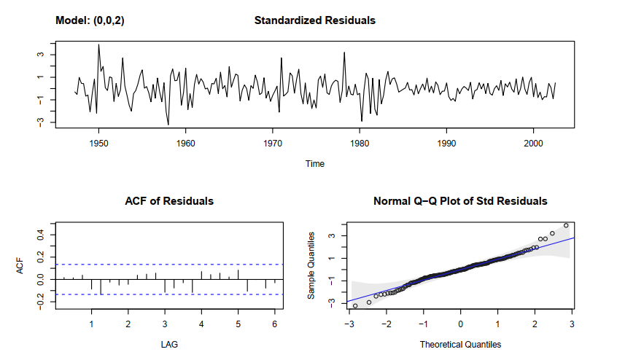
Example 3.40 Diagnostics for GNP Growth Rate
We will focus on the MA(2) fit from Example 3.39 Figure displays a plot of the standardized residuals, the ACF of the residuals, a boxplot of the standardized residuals

Slide 36
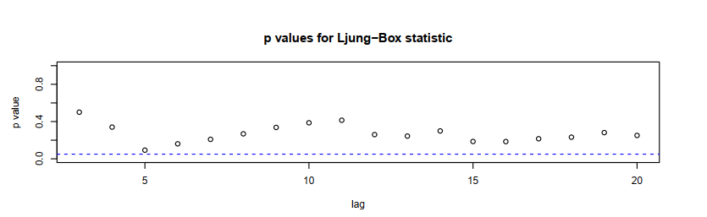
Example 3.40 Diagnostics for GNP Growth Rate
We will focus on the MA(2) fit from Example 3.39 Figure displays the p-values associated with the Q-statistic at lags H = 3 through H = 20 (with corresponding degrees of freedom H - 2).

Slide 37
Example 3.40 Diagnostics for GNP Growth Rate
Inspection of the time plot of the standardized residuals in Figure shows no obvious patterns. Notice that there may be outliers, with a few values exceeding 3 standard deviations in magnitude.
The ACF of the standardized residuals shows no apparent departure from the model assumptions, and the Q-statistic is never significant at the lags shown.
The normal Q-Q plot of the residuals shows that the assumption of normality is reasonable, with the exception of the possible outliers

Slide 38
Final’s practice. Textbook problems
Section 3.6.
Problems 3.27, 3.28.
Section 3.7
Problems 3.31, 3.32

Slide 39
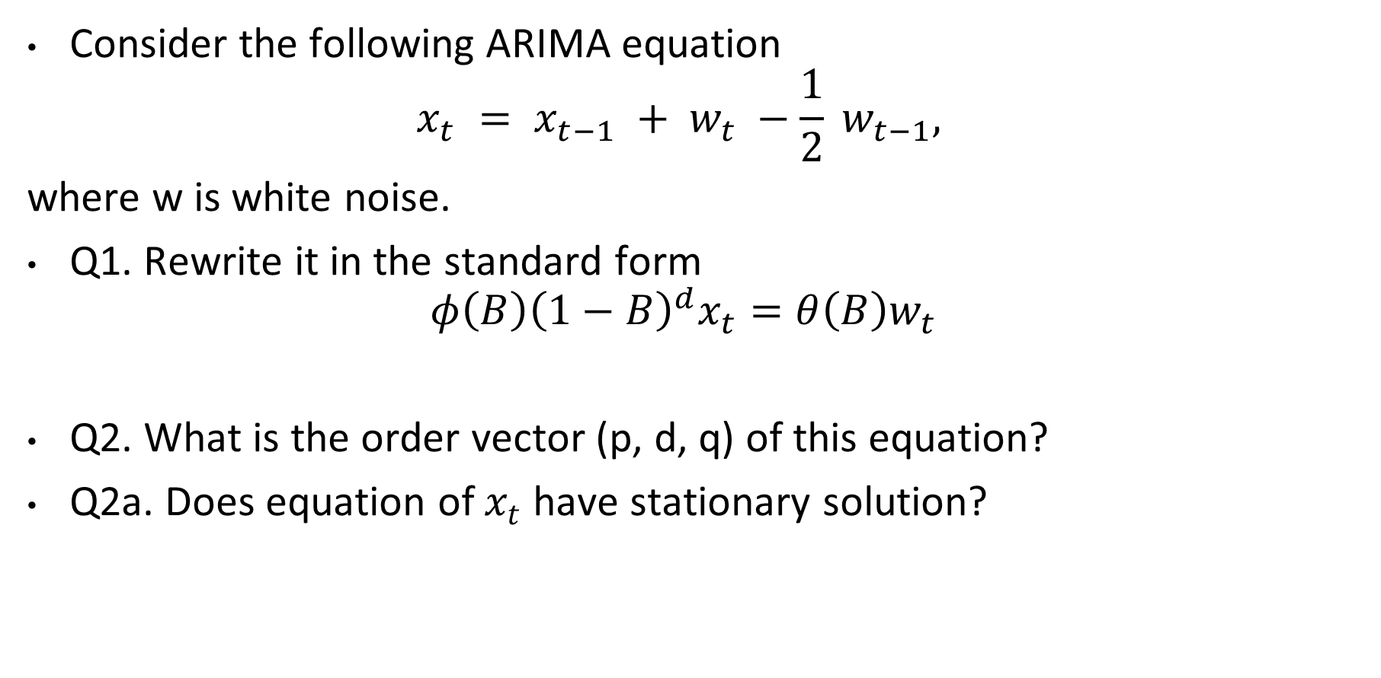
Final’s practice.
Consider the following ARIMA equation
$$x_{t} = x_{t−1} + w_{t} −\frac{1}{2} w_{t−1},$$
where w is white noise.
Q1. Rewrite it in the standard form
$$φ\left(B\right){\left(1−B\right)}^{d}x_{t}=θ\left(B\right)w_{t}$$
Q2. What is the order vector (p, d, q) of this equation?
Q2a. Does equation of $x_{t}$have stationary solution?

Slide 40
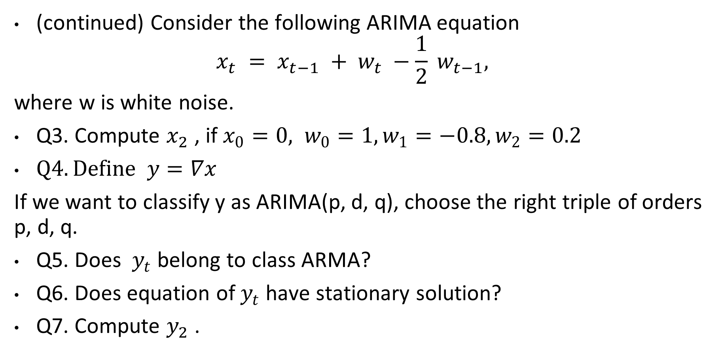
Final’s practice.
(continued) Consider the following ARIMA equation
$$x_{t} = x_{t−1} + w_{t} −\frac{1}{2} w_{t−1},$$
where w is white noise.
Q3. Compute $x_{2}$ , if$x_{0}=0, w_{0}=1, w_{1}=−0.8, w_{2}=0.2$
$Q4. Define y=∇x$
If we want to classify y as ARIMA(p, d, q), choose the right triple of orders p, d, q.
Q5. Does $y_{t}$belong to class АRМА?
Q6. Does equation of $y_{t}$have stationary solution?
Q7. Compute $y_{2}$ .

Slide 41
Final’s practice.
(continued) Consider the following ARIMA equation
$$x_{t} = x_{t−1} + w_{t} −\frac{1}{2} w_{t−1},$$
where w is white noise.
Q3. Compute $x_{2}$ , if$x_{0}=0, w_{0}=1, w_{1}=−0.8, w_{2}=0.2$
$Q4. Define y=∇x$
If we want to classify y as ARIMA(p, d, q), choose the right triple of orders p, d, q.
Q5. Does $y_{t}$belong to class АRМА?
Q6. Does equation of $y_{t}$have stationary solution?
Q7. Compute $y_{2}$ .

Slide 42
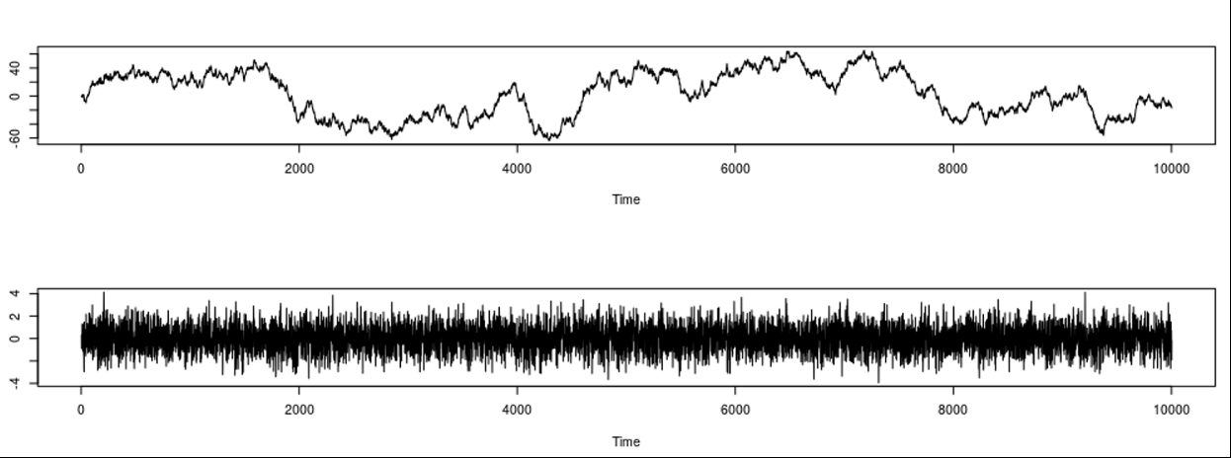

Final’s practice.
(continued) Consider the following ARIMA equation
$$x_{t} = x_{t−1} + w_{t} −\frac{1}{2} w_{t−1},$$
where w is white noise.
Q7. We continued collecting the data $x_{t}$ and transforming it into $y_{t}$.
Match the two pictures below to $x_{t}$and $y_{t}$.

